Slide 1
MP5 — FINAL PORTFOLIO
MiniClaw Gripper
Design, Verification, and What I Learned to Distrust
A force-efficient four-bar gripper, verified three independent ways.
Jinu · Mechanical Engineering · Mini-Project 5
Notes:
~0:30
Good afternoon. I'm Jinu, and this is the MiniClaw — a hand-driven, four-bar gripper I scaled down from ACME's BigClaw.
The subtitle is the honest version of this talk: design, verification, and what I learned to distrust. I checked this gripper three independent ways — but the most useful thing I'll show you today isn't one of the numbers that agreed. It's the one that didn't, and how I caught it. Let me walk the whole arc, MP1 through Part B, across all five pillars.

Slide 2
GOAL & DIRECTION
The brief, and the choice that shaped everything
Scale the BigClaw down: 0–86 mm jaw → ~40 mm MiniClaw target.
Fit one side inside the 46 × 55 mm half-envelope.
Other side mirrors; total jaw = 2 × single-side displacement.
THE DESIGN DRIVER I CHOSE
Force efficiency
Keep the transmission angle near 90° across the whole stroke — not just chase maximum opening.
This one decision is why the linkage came out the way it did.
Notes:
~1:10 • GOAL & DIRECTION
Start with Goal and Direction — the brief, and the one decision that shaped everything.
The ask was a scale-down: take the BigClaw to about 20% smaller — a 92 × 46 × 55 mm envelope — fully 3D-printable in PLA, hand-driven by a thumb wheel, under 15 parts. The two jaws sit side by side across that width, so each side has to live inside a 46 × 55 mm half-envelope, and total jaw opening is two times one side.
But the requirement that actually mattered wasn't the opening — it was GRIP FORCE. The brief asks for at least 5 to 8 newtons per jaw on a 25 mm object, by hand. For perspective: the aluminum BigClaw this replaces only manages about 5 newtons total — with a servo. I had to match that, in plastic, turned by a thumb.
So here's the decision. The brief handed me a force target, not a stroke target — so I refused to make maximum opening the design driver. I made FORCE EFFICIENCY the driver: keep the transmission angle near 90 degrees across the entire stroke, because that's what delivers grip force everywhere, not just at one lucky position. Get the force right by design, and the opening takes care of itself.
That single choice is why this linkage looks the way it does. Hold onto it — it's also the reason I caught the AI being wrong later.

Slide 3
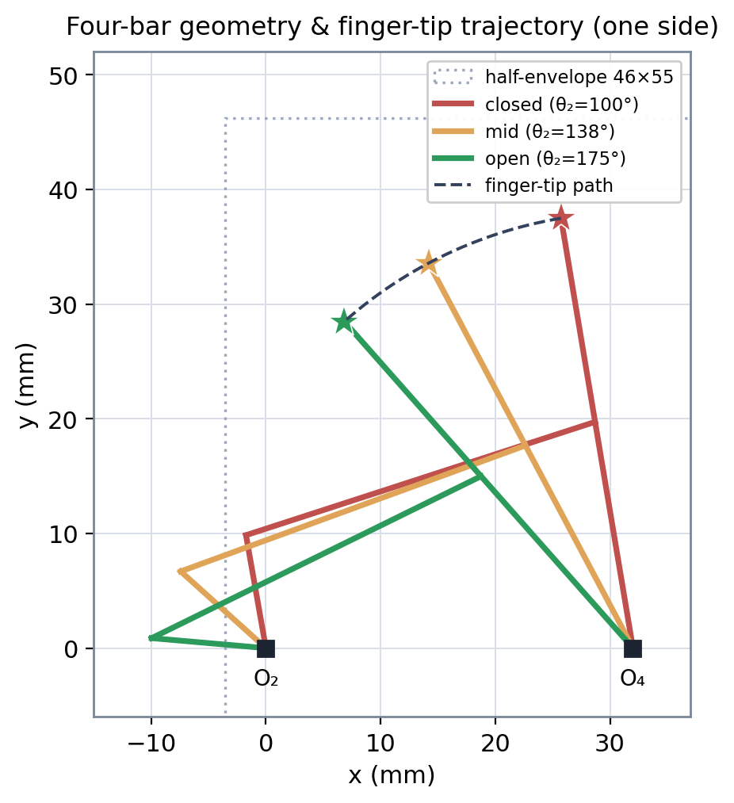
THE DESIGN
Grashof crank-rocker, one side
Ground r₁
32 mm
Input crank r₂
10 mm
Coupler r₃
32 mm
Output rocker r₄
20 mm
Finger from O₄
38 mm
Input sweep
100° → 175° (75°)
Grashof crank-rocker — input crank fully rotatable, drivable by a continuous gear train.
Notes:
~0:50
Here's the geometry — a Grashof crank-rocker. Ground link 32, input crank 10, coupler 32, output rocker 20, with a 38 mm finger off the output pivot. The crank sweeps 100 to 175 degrees — 75 degrees of travel.
Grashof matters for one practical reason: the input crank rotates fully. That means I can drive it with a continuous gear train, instead of something that has to stop and reverse at the ends. The plot is the finger-tip path for one side — closed in red, mid in orange, open in green. The other jaw is an exact mirror.

Slide 4
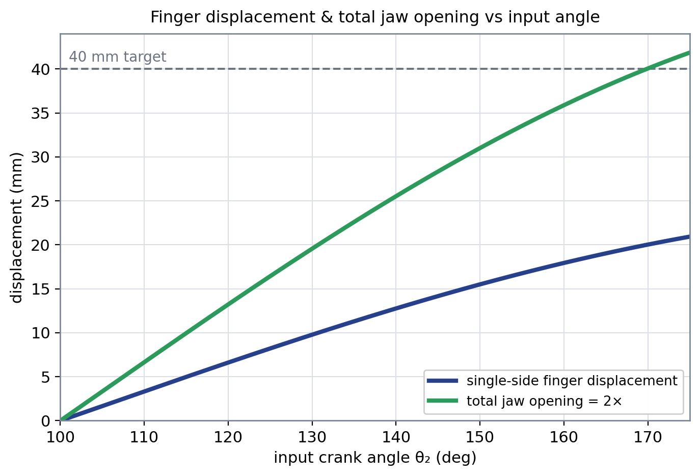
ANALYSIS 1 — POSITION
0 → 41.9 mm jaw, monotonic
41.9 mm
total jaw opening
Single-side: 20.9 mm
Monotonic — no motion reversal across the sweep.
Notes:
~0:40
First check — position. One side travels 20.9 millimeters, so the total jaw is 41.9 against a 40 mm target. We clear it.
The line that matters is the green one, and the word that matters is MONOTONIC — the jaw opens steadily across the whole sweep and never doubles back. That's something you confirm, not assume: a four-bar can absolutely reverse on you mid-stroke. This one has the decency not to.

Slide 5
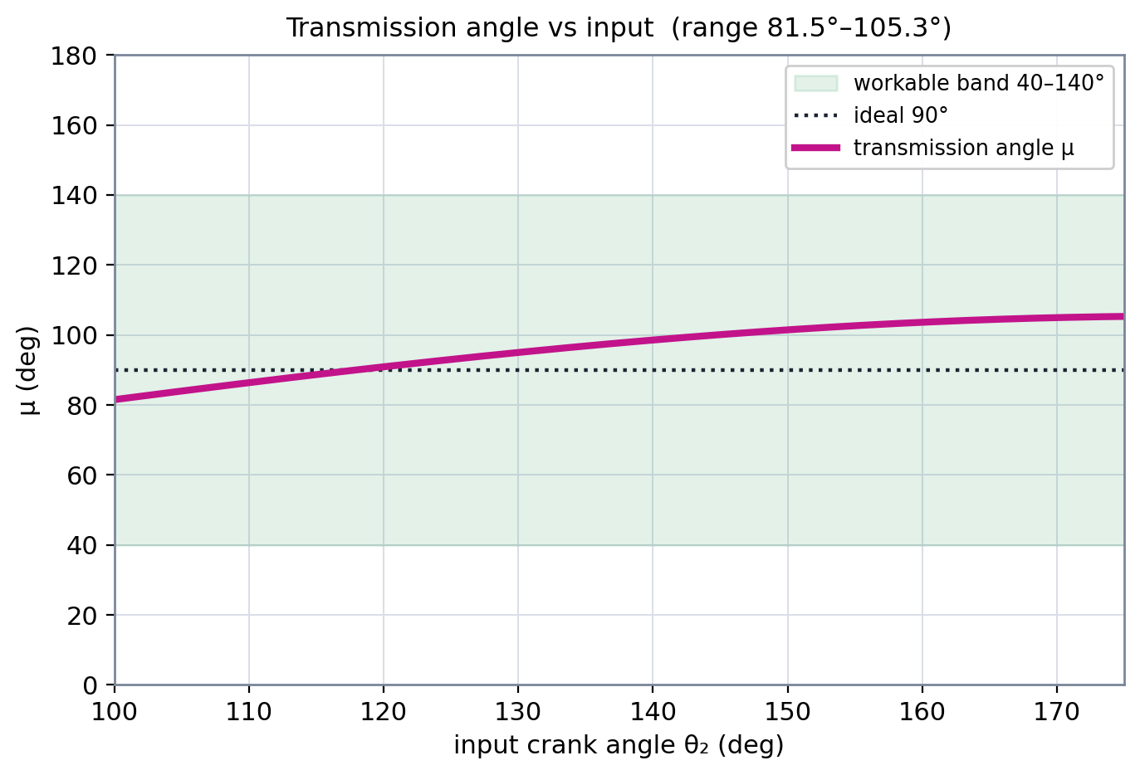
ANALYSIS 2 — TRANSMISSION ANGLE
Why I picked this geometry
81.5°–105.3°
μ across full sweep
Straddles the ideal 90°.
Never within 38° of a singularity — strong, uniform output force everywhere.
Notes:
~1:10
This is the slide that justifies the whole geometry — and it's the payoff for the force-first decision back on slide two.
Transmission angle — I'll call it mu — stays between 81.5 and 105.3 degrees across the entire sweep. It straddles the ideal 90 and never comes within 38 degrees of a singularity. In plain terms: strong, even output force everywhere in the stroke, not just at one sweet spot.
Why 90, and why those edges? That's standard four-bar practice — keep mu near 90, and never let it leave the 40-to-140 band, or friction wins and the mechanism binds. That rule is what turns a lazy question — "is it inside the band?" — into the right one: "is the force strong across the WHOLE stroke?" Hold that exact distinction in your head, because it's the question the AI didn't ask. I'll come back to it.

Slide 6
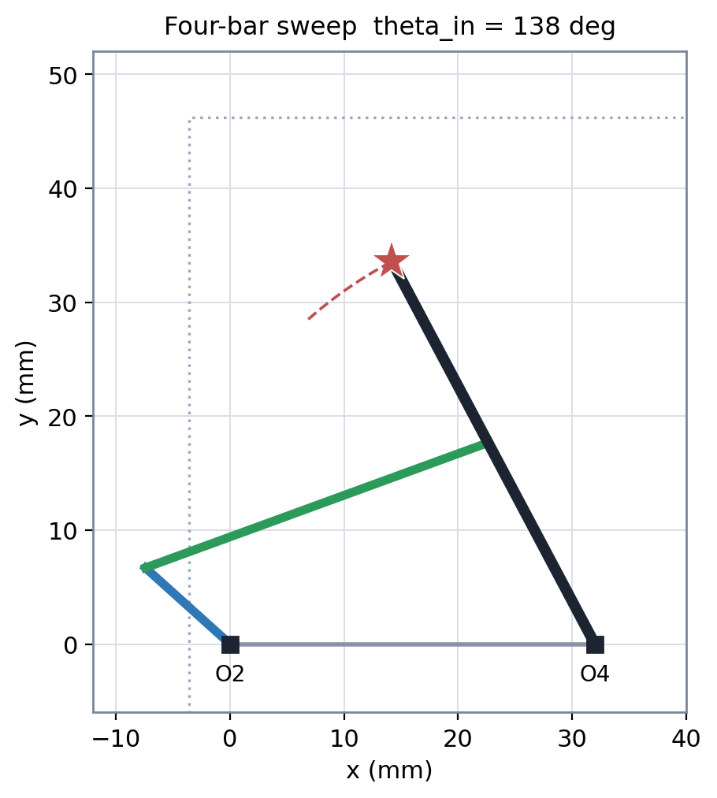
ANALYSIS 3 — INTERFERENCE & MOTION
Nothing binds, everything fits
5.18 mm
minimum link-to-link clearance — no crossings
2.02 mm
minimum wall clearance — fits the half-envelope (tight on width)
Full open → close cycle runs live in the demo (slide 12).
Notes:
~0:40
Second check — does anything bind, and does it all fit. Minimum link-to-link clearance is 5.18 millimeters, so nothing crosses anywhere in the cycle. Minimum wall clearance is 2.02 millimeters — it fits the half-envelope. I'll be straight with you: that's tight on width, and I've flagged it.
This is one frozen pose — you'll see the whole open-to-close cycle move, live, in the demo at the end.

Slide 7
EVALUATION & TRUST
Triangulation: three paths, one answer
Hand calc
Simulation
AI analysis
Closed-form circle intersection, 3 poses
240-step sweep, motion artifact
Parameter sweep + review loops
All three agree to < 0.1 mm on tip position and to the same μ band. The < 0.1 mm gap is rounding, not disagreement.
If they ever disagreed, I trust the hand calc — the closed form is exact for matched link lengths, so the function would be the thing to debug.
Notes:
~0:55 • EVALUATION & TRUST
Now Evaluation and Trust — and the first thing I did was refuse to trust any single method.
I checked this three independent ways. Hand calculation — closed-form circle intersection at three poses. Simulation — a 240-step sweep with a motion artifact. And AI analysis — a parameter sweep with review loops.
All three land within a tenth of a millimeter on tip position, and on the same mu band. That gap isn't disagreement — it's rounding. And if they ever HAD split, I can tell you which one wins: the hand calc. The closed form is exact for matched link lengths — so if the sim or the AI drifted from it, I'd go debug the code, not the math.

Slide 8
THE WRONG-AI MOMENT
When the AI was confidently wrong
The first AI parameter sweep handed me a linkage that hit the 40 mm jaw target — but let the transmission angle drop to ~58° near full open.
THE LESSON
The AI satisfied the letter of the spec while missing its intent.
It passed a naive “is it in the 40–140° band?” check, so it looked acceptable. I caught that it had optimized stroke in isolation, forced a re-run with a μ penalty, and converged on 32/10/32/20 — μ 81.5–105.3°.
Knowing the real acceptance criteria is the engineer's job.
Notes:
~2:50 • CENTAUR ENGINEERING ← CENTERPIECE — slow down. Claim, truth, catch, fix.
This is the one I want you to walk out remembering.
WHAT THE AI CLAIMED. My first parameter sweep handed me back a linkage that hit the 40 mm jaw target cleanly. On paper, done. It even passed a band check — is the transmission angle inside 40 to 140? Yes. Quick look, you'd ship it.
WHAT WAS ACTUALLY TRUE. That linkage let the transmission angle collapse to about 58 degrees near full open. Still technically in the band — but nowhere near 90. And that's the whole ballgame, because it means the grip force falls off a cliff at exactly the moment the jaw is wide open and you're trying to hold something. The AI had optimized stroke in isolation. It satisfied the letter of the spec and missed the entire point of it.
HOW I CAUGHT IT. Because of the decision on slide two. I'd already locked force efficiency in as the real acceptance criterion — so I wasn't asking "did it open far enough," I was asking "is mu strong across the whole stroke." The second I plotted mu instead of just range-checking it, the dropout near full open was impossible to miss.
WHAT I DID. I added a mu penalty to the objective — punish any geometry that lets mu wander from 90, not just one that leaves the band — and re-ran. It converged on 32, 10, 32, 20. Mu 81.5 to 105.3. The design you've been looking at all talk.
And that's CENTAUR ENGINEERING in a single loop. Neither of us gets there alone. The AI ground through a parameter space I'd never search by hand. But it could not supply the missing constraint — because I was the one who knew the real acceptance criterion was never in the prompt. The AI explores fast. The human knows what "good" has to mean. The AI satisfied the spec; knowing the spec was wrong was my job.

Slide 9
TOOLS & INTEGRATION — PART B
Drive train: 12:1, synchronized
Architecture
Compound spur + 1:1 sync pair
COUPLING CHECK
Reduction N
12 : 1 (2.5 thumb turns → 75° sweep)
N doesn't change the linkage — it only maps thumb turns to the same 75° sweep.
Stage 1
12T → 48T (4:1)
Stage 2
16T → 48T (3:1)
✓ μ stays 81.5–105.3° — reduction keeps the linkage in band.
Sync pair
40T ↔ 40T (counter-rotating)
Notes:
~1:05 • TOOLS & INTEGRATION
Tools and Integration — the Part B build.
The drive train is a compound spur gearset plus a 1:1 synchronizing pair. Total reduction 12-to-1 — so about two and a half turns of the thumb wheel gives the full 75-degree sweep. Stage one, 12 teeth into 48, 4 to 1. Stage two, 16 into 48, 3 to 1. Sync pair, 40 to 40, counter-rotating — so both jaws mirror exactly.
And here's the one line that matters: the reduction does not touch the linkage. It only remaps how many thumb-turns produce that same 75 degrees. So mu stays 81.5 to 105.3 — the gearing changes how the input FEELS, not the physics of the grip.

Slide 10
DFM — THE HONEST CUT
What I would not send to the print queue tomorrow
m = 1.0 mm gear teeth
Root fillet ~0.38 mm is below the comfortable FDM feature. Print one test gear first; m = 1.25 fallback ready.
27 parts vs. < 15 target
Drive train drives the count. Merges named for MP5: combine stage gears, single-shell housing.
2 mm envelope margin
Tight on width — must be re-confirmed in 3D once wall thickness and pin heads are added.
Notes:
~0:55 • CONTEXT MANAGEMENT
The honest cut — what I would NOT send to the print queue tomorrow.
First, the module-1 gear teeth. On a standard involute gear the root fillet runs about 0.38 times the module — so at module 1, that's roughly 0.38 of a millimeter. That's right at the edge of what our printers resolve, because the fab floor runs Prusa MK4S machines with 0.4 mm nozzles. So: print one test gear first, with a module 1.25 fallback ready.
And this is CONTEXT MANAGEMENT earning its keep. None of those numbers came off a random internet datasheet. They came from ACME's own knowledge base — the same corpus I researched in MP2 and then put behind a RAG in MP3. We're not printing "generic PLA," we're printing FilaTech PolyPro PLA+, and its interlayer adhesion — the number that actually decides whether a gear tooth survives — is meaningfully different from a generic spec. And I'm not guessing at safety factors, because Elena Vasquez already fatigue-tested printed PLA spur gears to failure on the WidgetBot 2.0 program. Grounding the design in tested capability instead of internet defaults is the only reason these flags are real and not hand-waving.
Second, part count — 27 against a target of 15. Not my proudest number, and the drive train is the culprit — but I've named the merges to pull it back: combine the stage gears, single-shell housing.
Third, that 2 mm wall margin — tight, and it gets re-confirmed in 3D once wall thickness and pin heads go in.

Slide 11
EVALUATION & TRUST
Final trust ledger
WHAT I TRUST
WHAT STILL NEEDS CHECKING
μ 81.5–105.3° across the full sweep (hand calc + sim)
41.9 mm jaw, monotonic, agree to < 0.1 mm
No link crossings — 5.18 mm min clearance
Fits 46×55 half-envelope; Grashof, drivable
Drive train N=12:1, 1:1 sync, coupling check passes
Pin clearance & friction (ideal-joint model)
Input range depends on N — re-check if N changes
Symmetry holds only if sync built & verified
2 mm width margin in 3D stack-up
Gear tooth strength / backlash at m=1.0
Part count 27 vs. <15 target
Notes:
~0:55 • EVALUATION & TRUST
The trust ledger — and it closes out Evaluation and Trust.
What I trust: mu in band across the full sweep, hand calc and sim agreeing. The 41.9 jaw, monotonic, matching to under a tenth of a millimeter. No link crossings — 5.18 millimeters of clearance. It fits the envelope, it's Grashof, it's drivable. Drive train 12-to-1 with a passing coupling check.
What I don't trust yet — and I'll say it plainly. Pin clearance and friction, because my model assumes ideal joints. The input range, which moves if the gear ratio moves. The symmetry, which only holds once the sync pair is actually built and verified. The 2 mm margin in the real 3D stack-up. Gear tooth strength and backlash at module 1. And the part count.
The whole point of this slide: I can tell you exactly what I trust, and exactly what I don't.

Slide 12
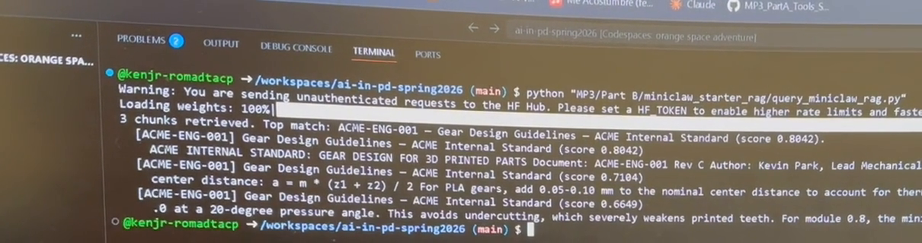
LIVE DEMO — TOOLS & INTEGRATION
It moves — and the AI runs live
1. It moves
2. It runs the AI live
A live function call into the RAG I built over ACME's knowledge base — real retrieval, run live in the terminal:
Top match: ACME-ENG-001 — Gear Design Guidelines (0.80) — the standard my DFM flags trace to.
Notes:
~2:00 ← THE CLIMAX
So let me show you — two parts: it moves, and it runs the AI live.
FIRST — it moves. [Animation plays on the left.] One crank driving both jaws, mirrored, the full open-to-close cycle. Readouts: input angle, transmission angle with an in-band badge, total jaw 0 to 41.9 mm. Mu holds in band the whole way out — the force-efficiency decision from slide two, live.
SECOND — it runs the AI live. [Terminal video plays along the bottom.] A real query into my RAG over ACME's knowledge base — "what PLA printing parameters does ACME use for gears?" — run live in the terminal. Top match: ACME-ENG-001, Gear Design Guidelines, score 0.80 — the same internal standard my DFM flags trace to. And the bottom chunk says "for module 1.25, 12 teeth" — the exact fallback I flagged on slide 10, straight from ACME's own standard. A number my tool went and got, not one I typed onto a slide.
[Optional: run it live on camera too — switch to your open terminal, run query_miniclaw_rag.py, read the top match back. The slide capture is your backup.]

Slide 13
THE DURABLE LESSON
The tools will be replaced.
The skill won't.
Knowing what a “good” answer actually has to satisfy — and auditing the AI against the constraint it quietly skipped — is what transfers to any mechanism and any tool I'm handed next.
Thank you · Questions?
Notes:
~0:40
Let me close on the thing that actually transfers.
The tools will be replaced. The skill won't. Knowing what a "good" answer has to satisfy — and auditing the AI against the one constraint it quietly skipped — that carries over to any mechanism, and any tool, I get handed next. That's the whole job.
That's the MiniClaw. Thank you — I'm glad to take questions.
────────────────────────
Q&A — answers loaded:
• Why module 1 if the fillet's borderline? — Packaging drove it; I have the 1.25 fallback + test-gear-first plan. Known constraint, not an oversight.
• How do you know symmetry holds? — Once the sync pair is built and verified. That's why it's on the right side of the trust ledger.
• RobotExpo hook? (marketing) — Force-efficient grip across the full stroke: holds a fragile object as firmly wide-open as half-closed.
• Which DFM flag hits fab first? (fab) — The module-1 root fillet. One test gear before the set commits.
• Where did you trust the AI vs not? (leadership) — Trusted it to search the parameter space; did NOT trust it to know the acceptance criterion. Slide 8 is the answer.

